Slide 1
Prototyping
Changes - the earlier the better!

Slide 2
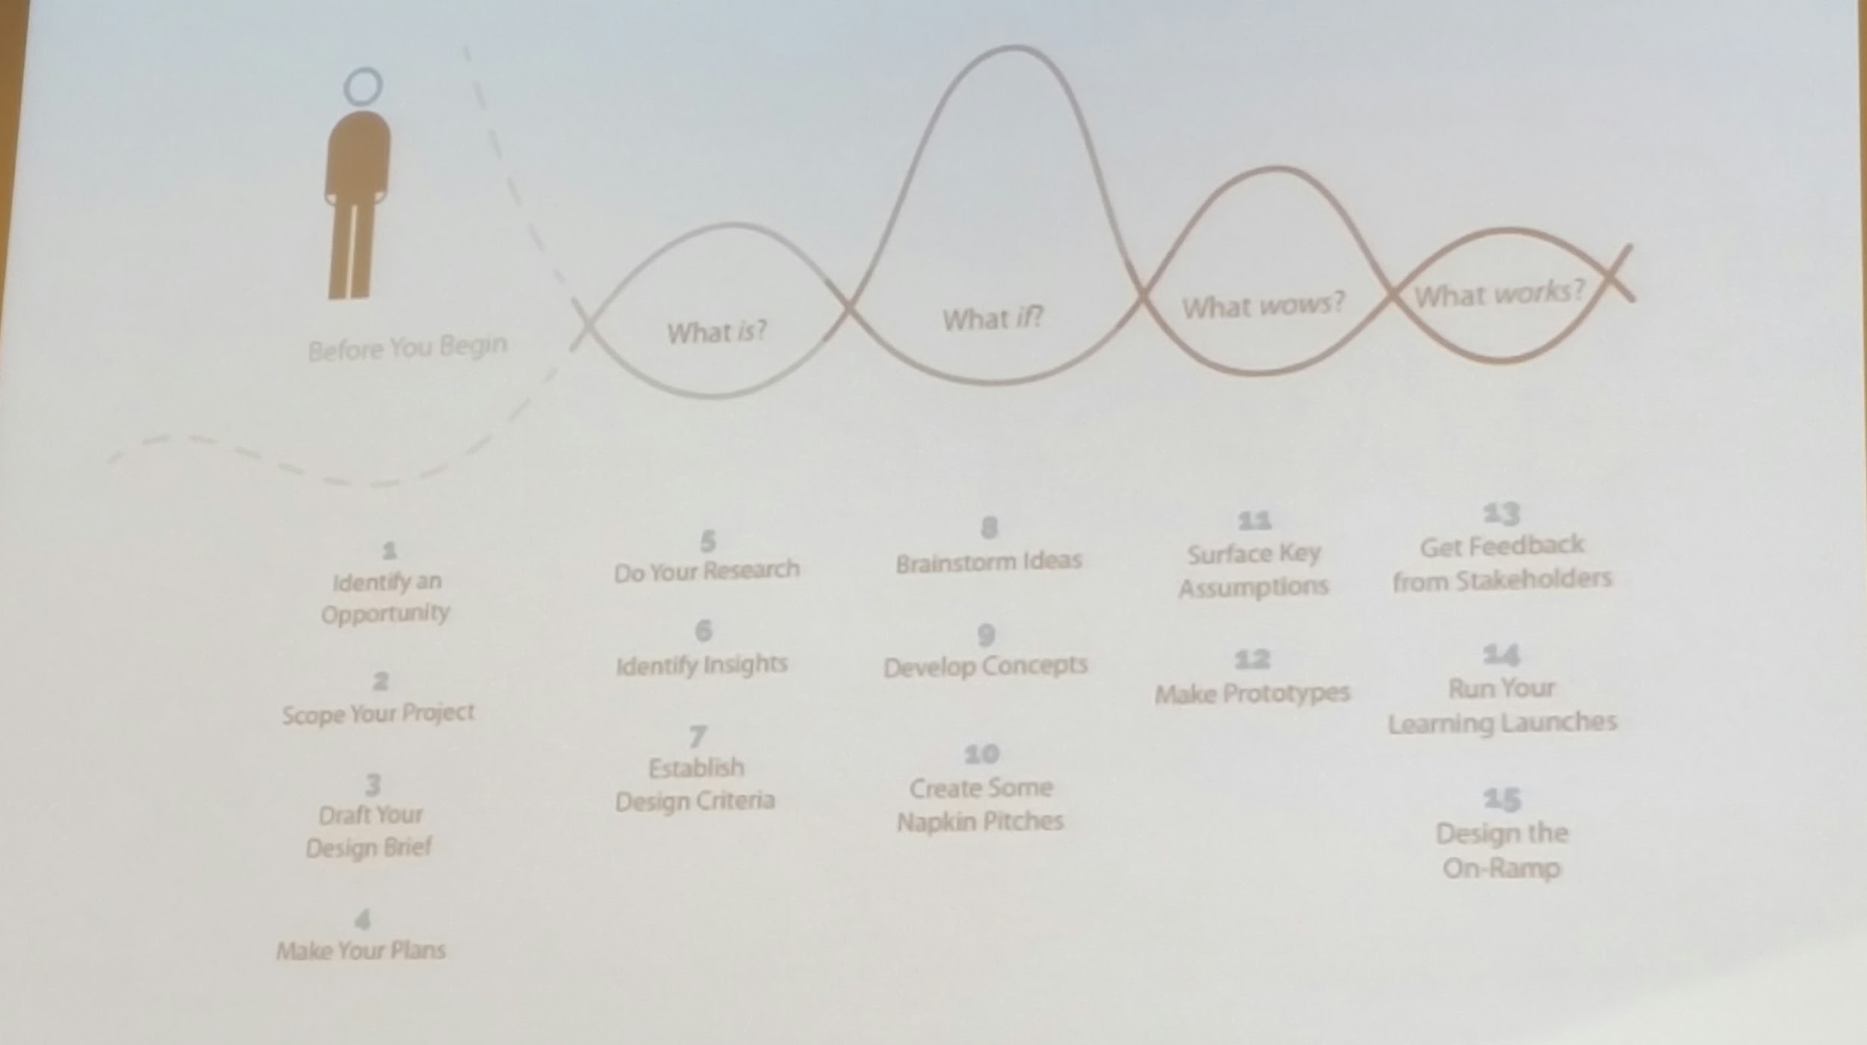
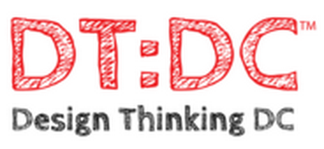
Design Thinking - UVA Darden approach
identify an opportunity
scope project
draft design brief
make plans What is?
do research
id insights
establish design criteria
brainstorm What if?
dev concepts
create napkin pitches What Wows?
surface key assumptions
make prototypes What Works?
get feedback from stakeholders
Run your learning Launches
Design the on-ramp

Slide 3
Opportunity
Reuse/repackage existing software to design a new set of PM tools to make the weekly report and Risk & Issues process easier.

Slide 4
Interview - Deep Empathy
Interviews:
8 PMs
2 PMO
4 PMO Admin

Slide 5
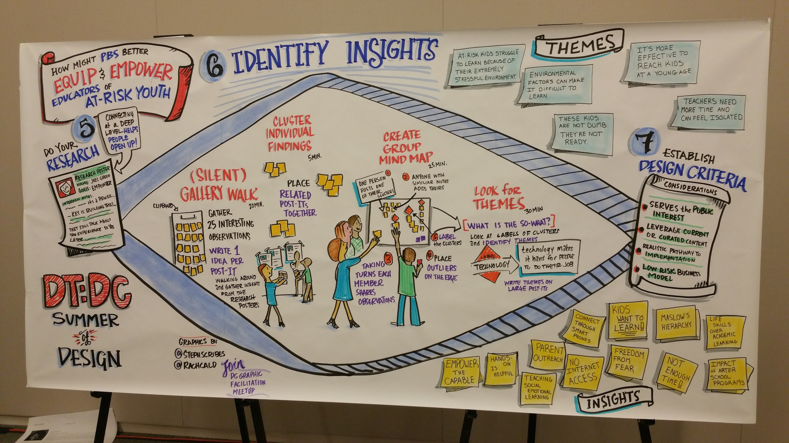
Insights & Design Criteria

Slide 6
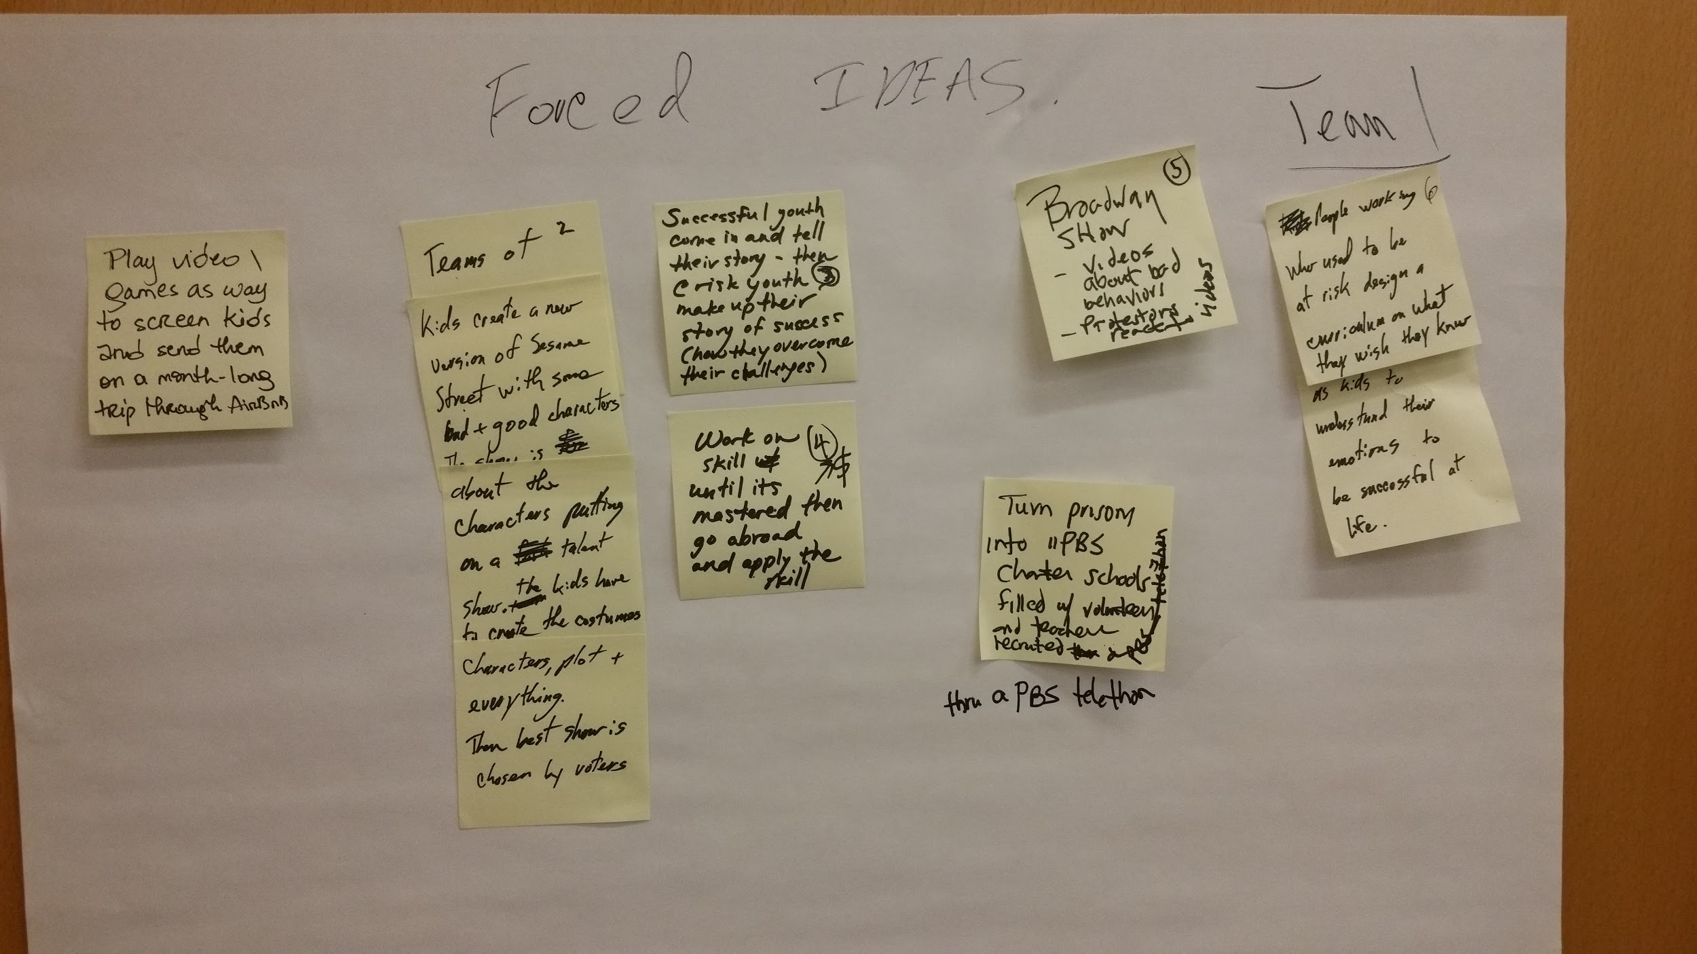
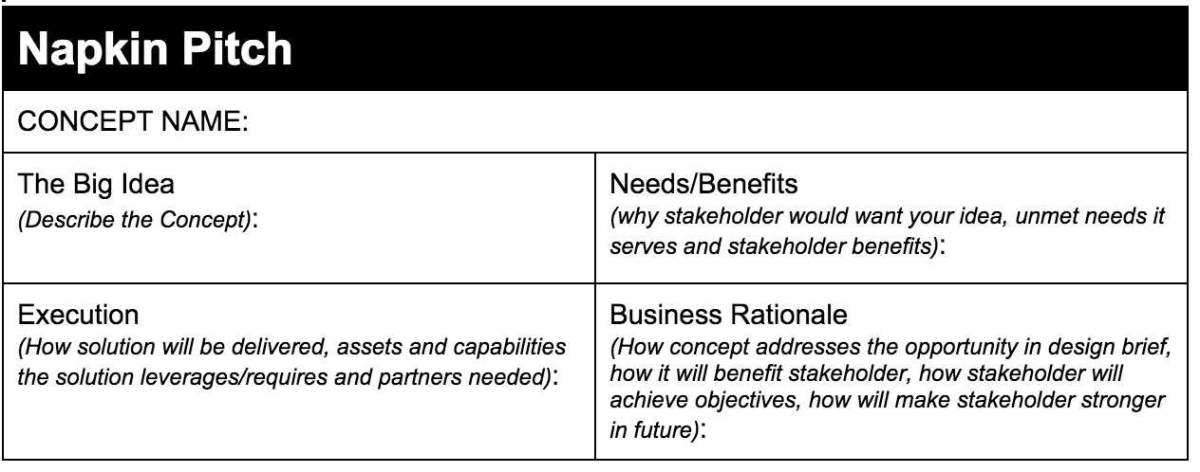
Brainstorming - Forced Connections - Napkin Pitches

Slide 7
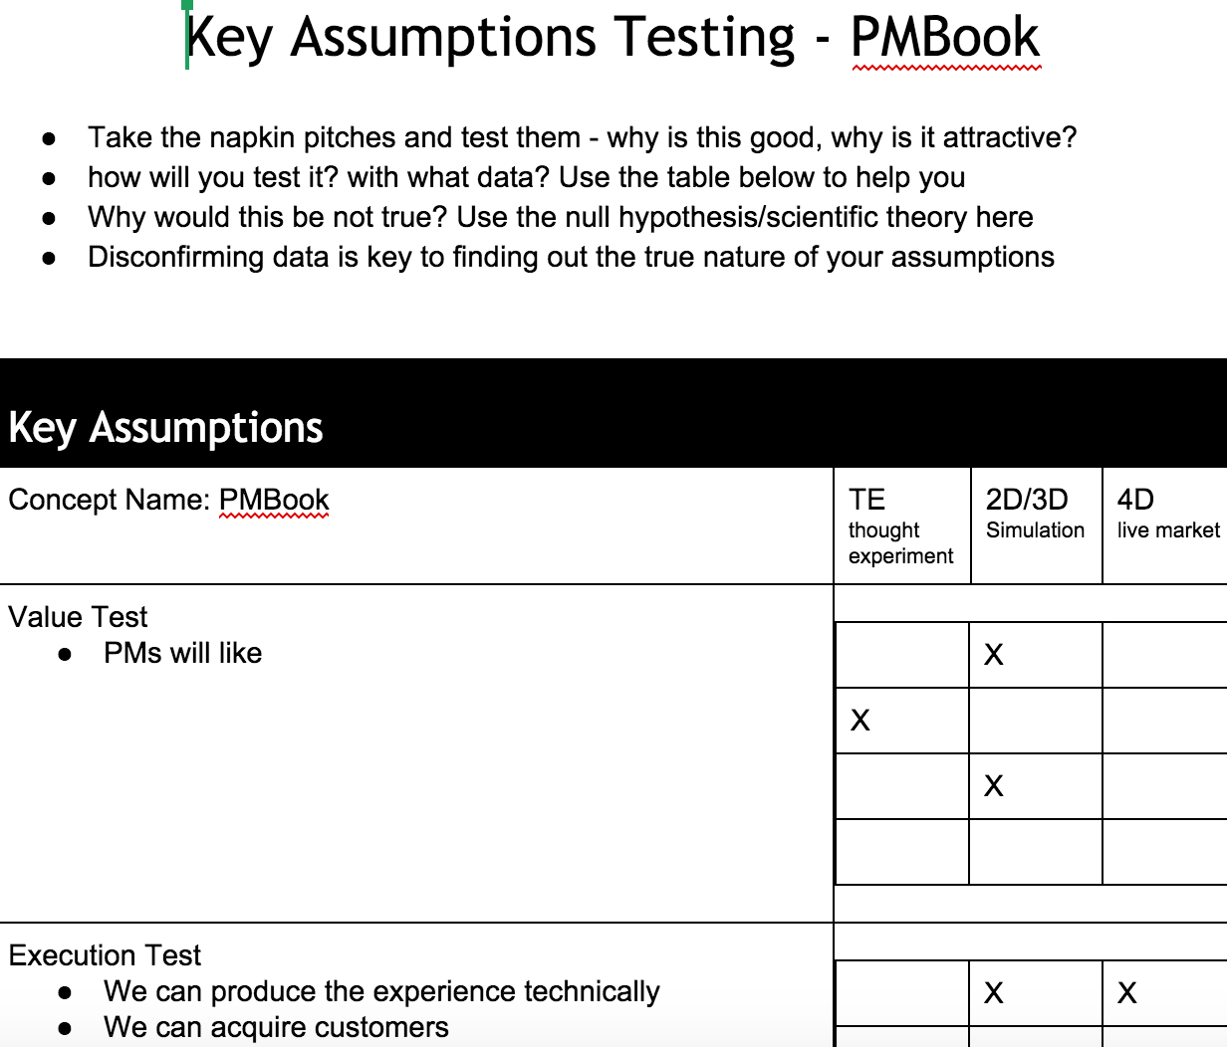
Key Assumptions - Test them!
Critical step in the process to uncover “unknown unknowns” and biases.

Slide 8
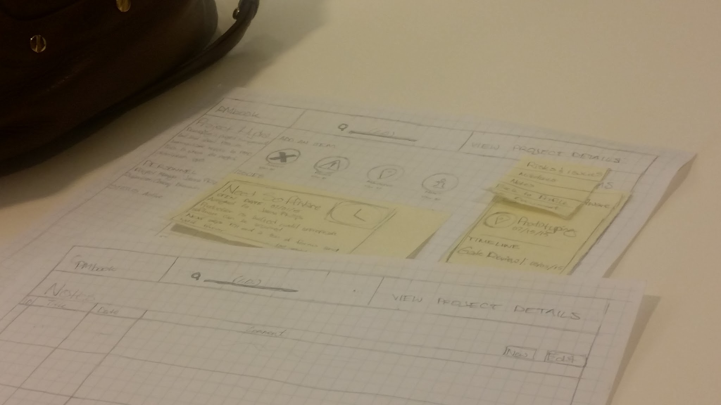
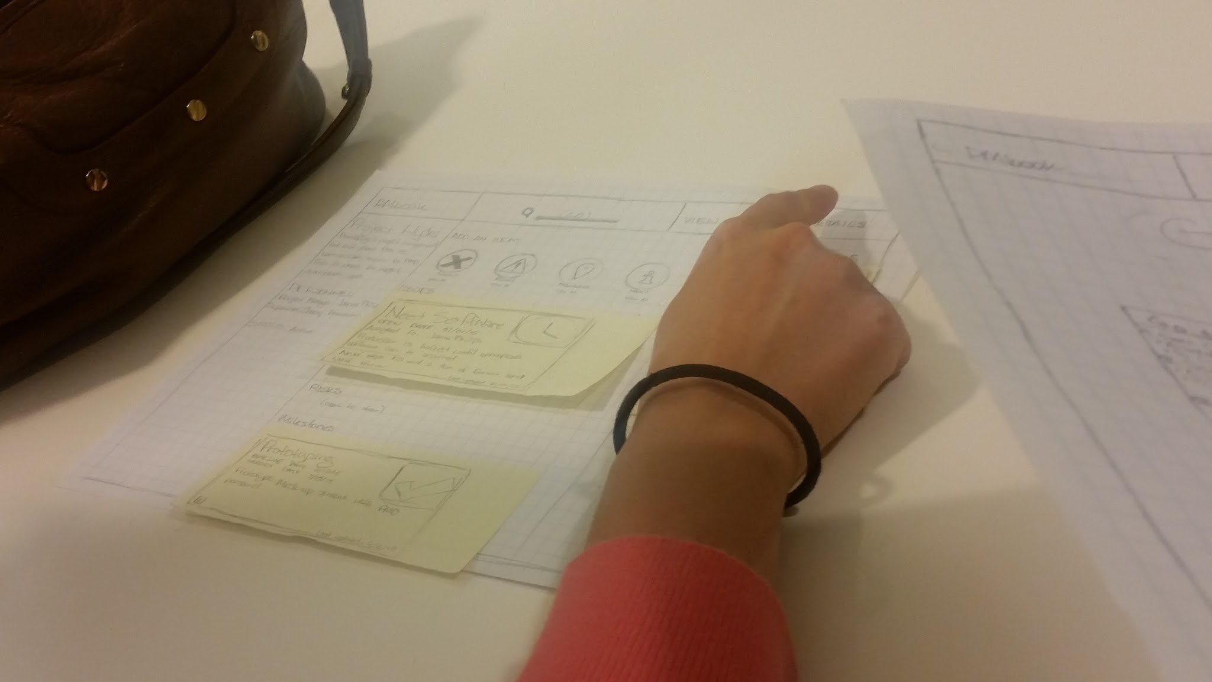
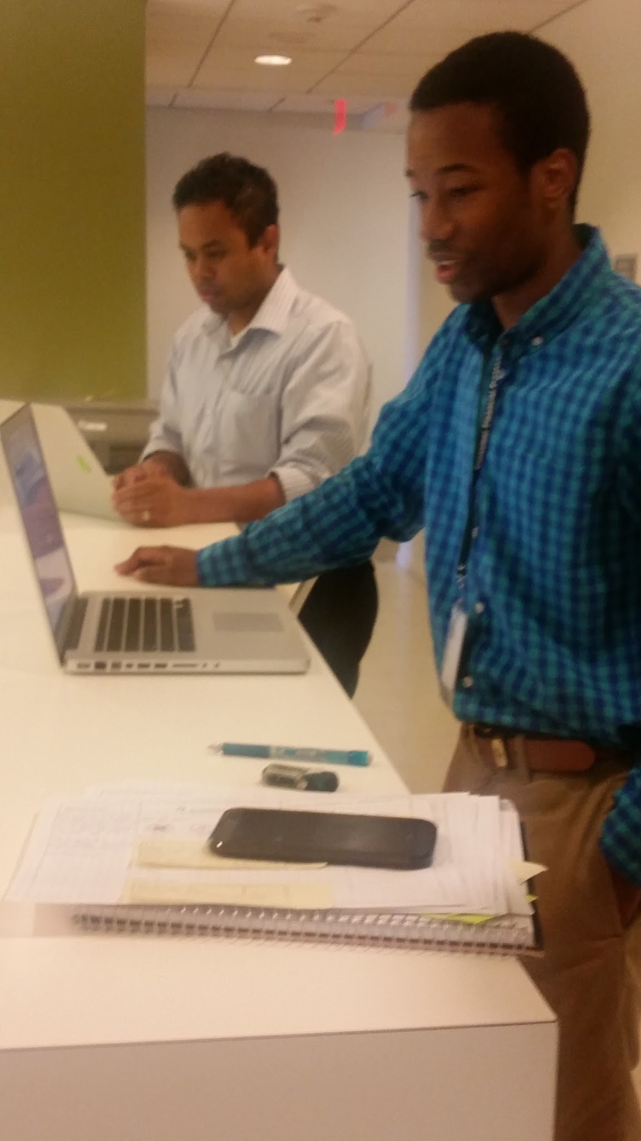
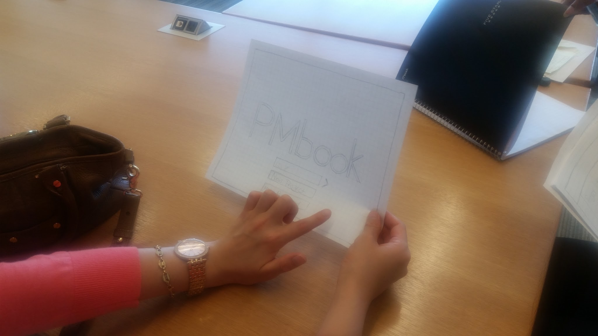
Prototypes
More screens
One “computer”, one “test subject”, 1 or more “observers”

Slide 9
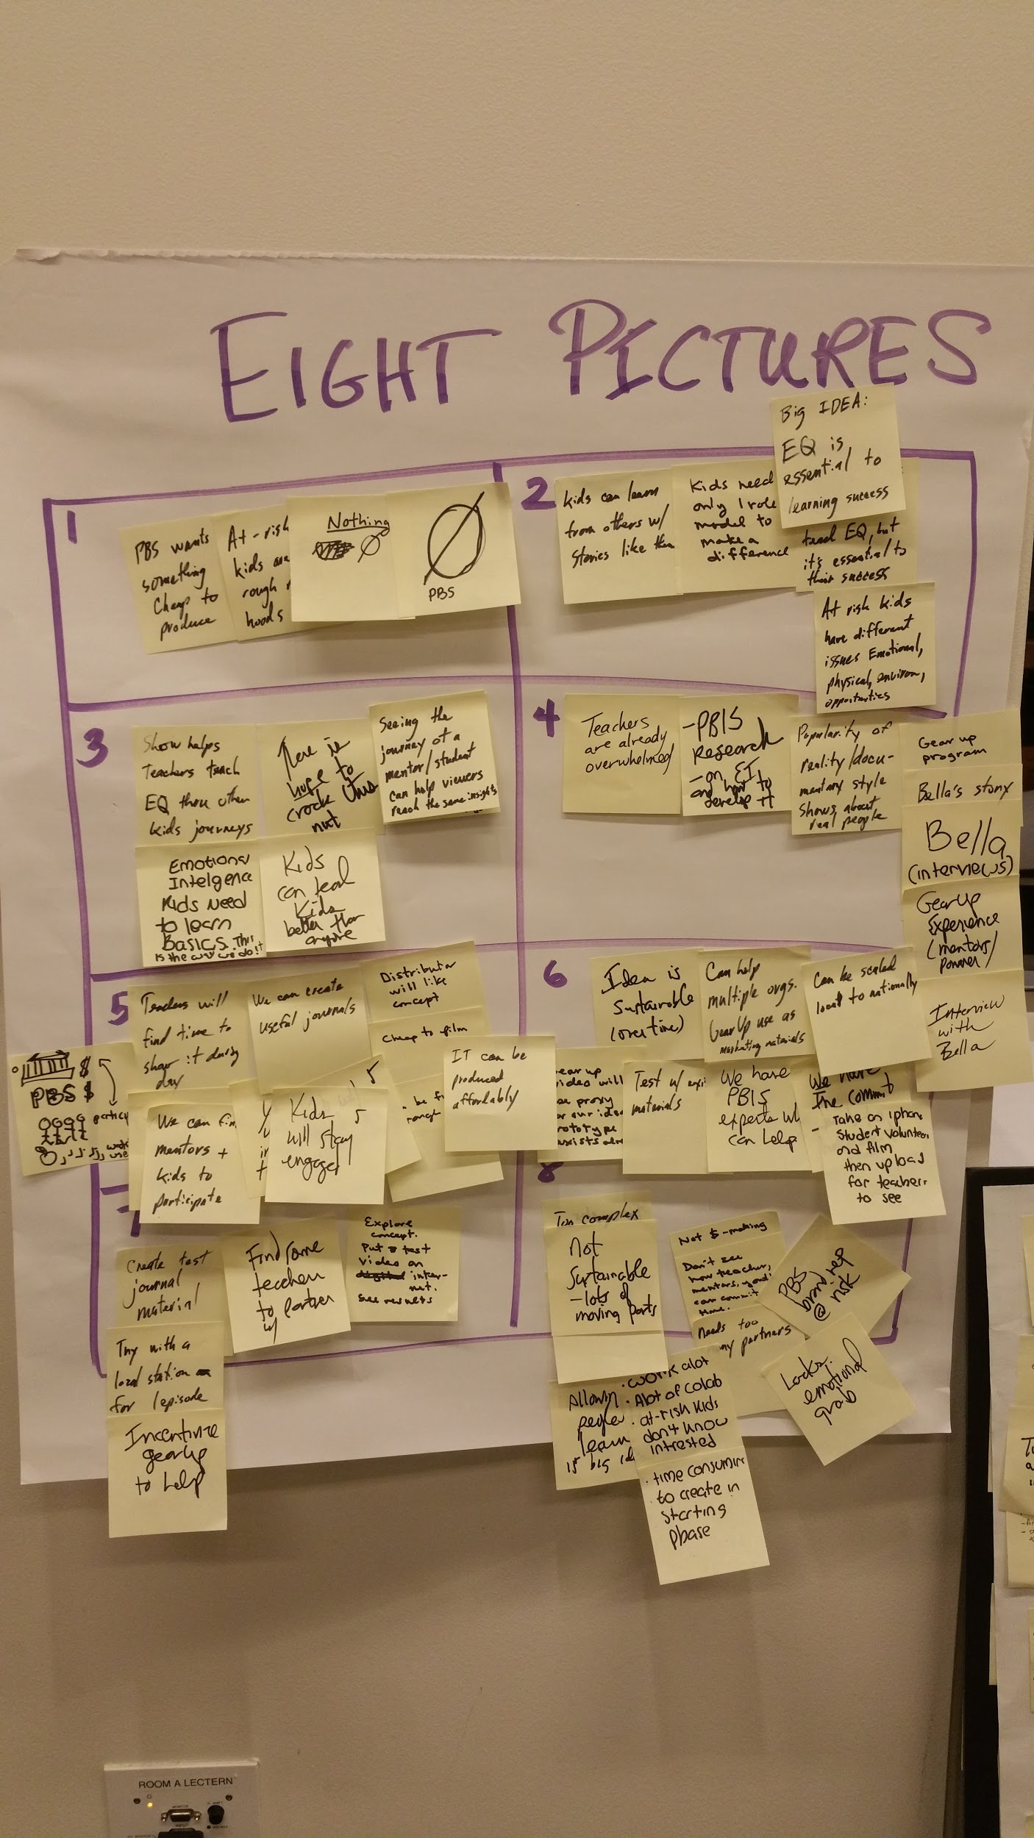
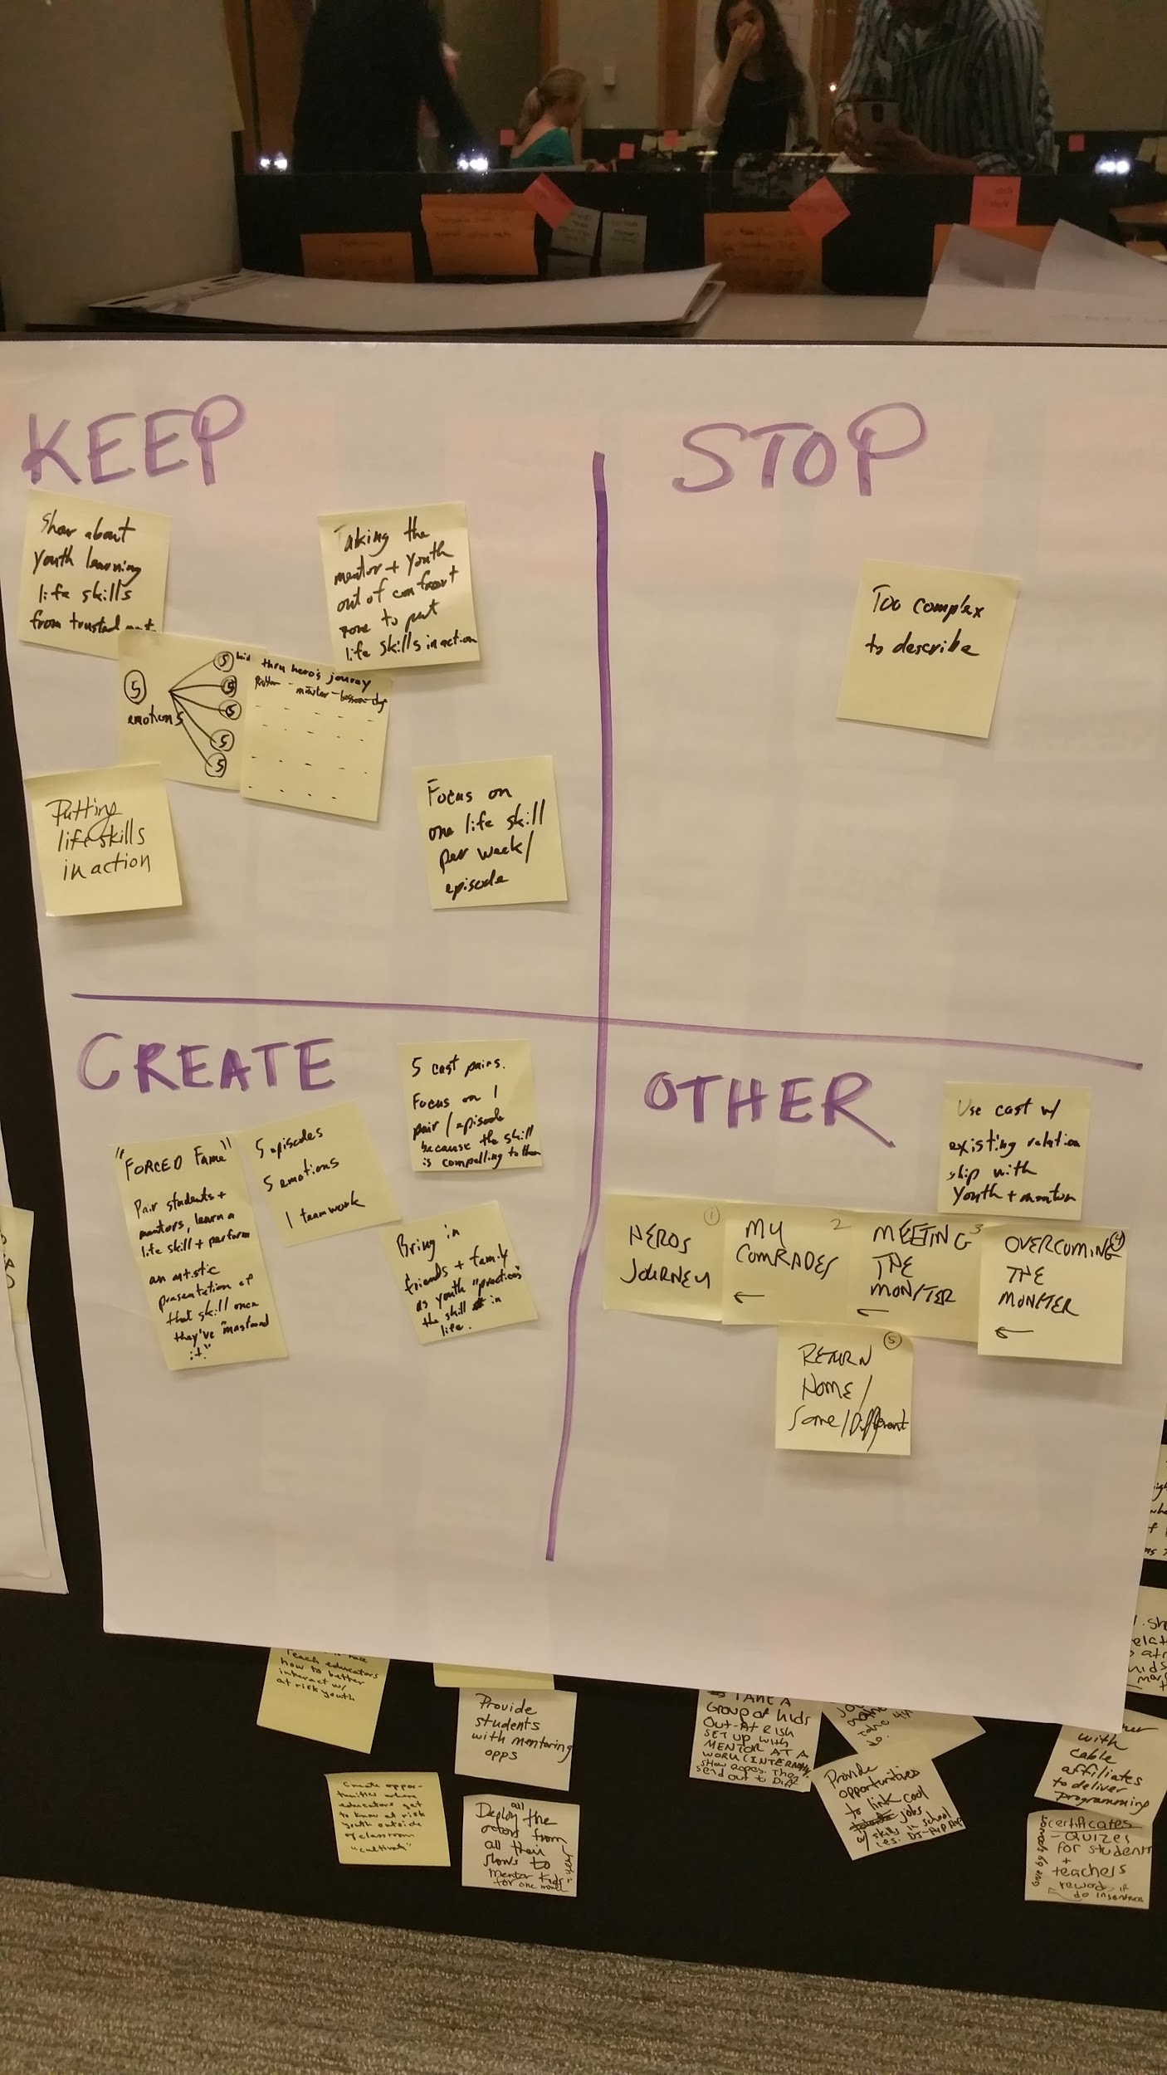
Feedback - Learning Launch - Onramp

